Slide 1
BioMedical Data Mining
BBM467 Data Intensive Applications
Data Science Capstone Project
Orhan Aytekin

Slide 2
Problem
The ultimate goal of biomedical data mining in healthcare applications is to seek for hidden trends, patterns from the voluminous data, and it is broadly utilized to predict various diseases in the medical industry.

Slide 3
Problem
1-) Unsupervised machine learning for discovering themes and topics from unstructured biomedical texts.
2-) How to analyze and visualize the evolving research trends in unstructured text data over time?
3-) Text-mining methods for discovering relationship between biological entities.

Slide 4
Data Understanding

Slide 5
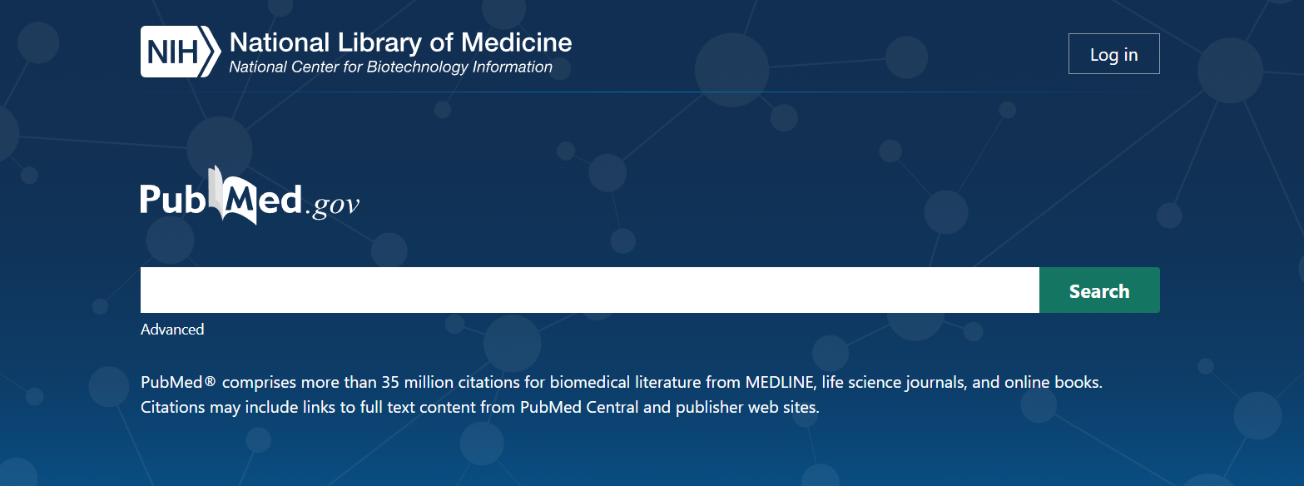
Data Understanding
I used PubMed for gathering the data.

Slide 6
Data Understanding
To access and download the data programatically from PubMed I used the API of National Center for Biotechnology Information (NCBI) it is called Entrez Databases and Retrieval System.

Slide 7
Data Understanding
To access and download the data programatically from PubMed I used the API of National Center for Biotechnology Information (NCBI) it is called Entrez Databases and Retrieval System.
Entrez is a molecular biology database system that provides integrated access to nucleotide and protein sequence data, gene-centered and genomic mapping information, 3D structure data, PubMed MEDLINE, and more. The system is produced by the National Center for Biotechnology Information (NCBI) and is available via the Internet.

Slide 8
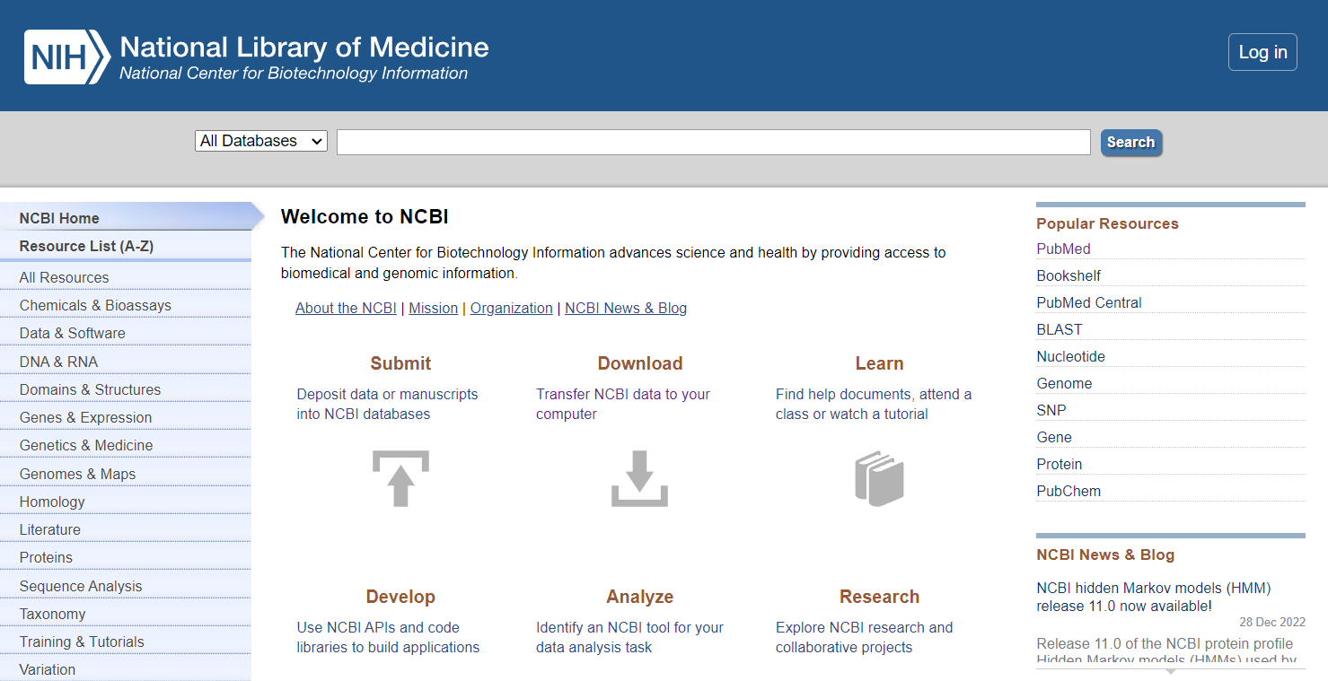
Data Understanding
National Center for Biotechnology Information Website

Slide 9
Data Understanding
For each article, we get dictionary objects that contains attributes of articles:

Slide 10
Data Understanding
For each article, we get dictionary objects that contains attributes of articles.
Such as it’s ID, date it’s published, title, abstract and so on.

Slide 11
Data Understanding
For each article, we get dictionary objects that contains attributes of articles.
Such as it’s ID, date it’s published, title, abstract and so on.
PMID: 19942596
OWN: NLM
STAT: MEDLINE
DCOM: 20100520
LR: 20211020
IS: 1464-3804 (Electronic) 0267-8357 (Print) 0267-8357 (Linking)
VI: 25
IP: 2
DP: 2010 Mar
TI: Newly identified CHO ERCC3/XPB mutations and phenotype characterization.
PG: 179-85
LID: 10.1093/mutage/gep059 [doi]
AB: Nucleotide excision repair (NER) is a complex multistage process involving…

Slide 12
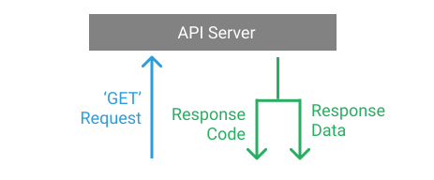
Data Preparation
Getting a data using an API consists of these 2 steps:

Slide 13

Data Preparation
Entrez requires, 2 cycle of API calls:
First is for searching articles that match with a query.
Second is for fetching the articles with those id’s.

Slide 14
Data Preparation
Entrez E-search
Entrez.esearch(db="pubmed", term=query, retmin=0,retmax=10_000)
Searches pubmed for a given query and returns a id_list of articles
retmax variable controls the count of returned articles

Slide 15
Data Preparation
Entrez E-fetch
Entrez.efetch(db='pubmed',id=pmid, rettype="Medline", retmode='text')
Returns the articles based on the pmid (Article ID)
It can either be a list of ID’s or a single id.

Slide 16
Data Preparation
Search queries for getting specific articles.
"The role of microRNAs in cancer development and progression"
"The use of CRISPR/Cas9 for gene editing in biomedical research"
"Base excision repair (BER)"
"Nucleotide excision repair (NER)"
"Non-homologous end joining (NHEJ)"
"Mismatch Repair (MMR)"
"Homologous recombination repair (HRR)"
"The development of nanotechnology-based therapies for cancer"
"The use of machine learning algorithms in medical diagnosis and treatment planning"

Slide 17
Data Preparation
These are the count of returned articles from the search query.
There are 5031 articles for the query The role of microRNAs in cancer development and progression.
There are 1070 articles for the query The use of CRISPR/Cas9 for gene editing in biomedical research.
There are 2599 articles for the query Base excision repair (BER).
There are 2928 articles for the query Nucleotide excision repair (NER).
There are 6055 articles for the query Non-homologous end joining (NHEJ).
There are 4828 articles for the query Mismatch Repair (MMR).
There are 556 articles for the query Homologous recombination repair (HRR).
There are 339 articles for the query The development of nanotechnology-based therapies for cancer.
There are 515 articles for the query The use of machine learning algorithms in medical diagnosis and treatment planning.

Slide 18
Data Preparation
Since some of the articles, for the given queries may collide, we need to remove the duplicates.
After deleting the duplicates:
Total distinct record count: 22887.

Slide 19
Data Preparation
After removing duplicates, the data is almost clean.
But we also need to discard the null values.
Since I will only use id’s, date of publication, titles and abstracts of each article,
it will suffice to check only these values.
For each article we have a dictionary, that contains that article’s attributes. Attributes I will use are:
Date of Publication "DP",
Abstract for "AB",
and "TI" for title

Slide 20
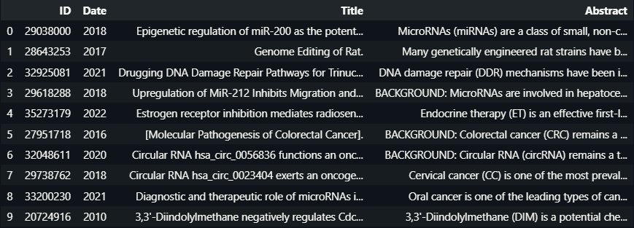
Data Preparation
After dropping null values, and putting the article’s id, date, title and abstracts into a dataframe it looks like this.
PS: Date of Publishing was a timestamp, I only get the year.

Slide 21
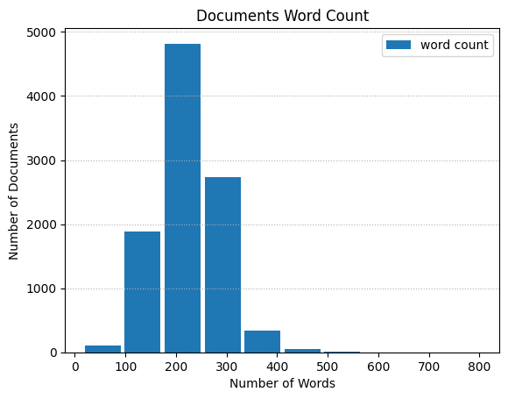
Data Preparation – Insights from Data
After concatenating each article's abstract and title and creating an another dataframe using id and word count values, I have plotted a bar plot using the dataframe object.

Slide 22
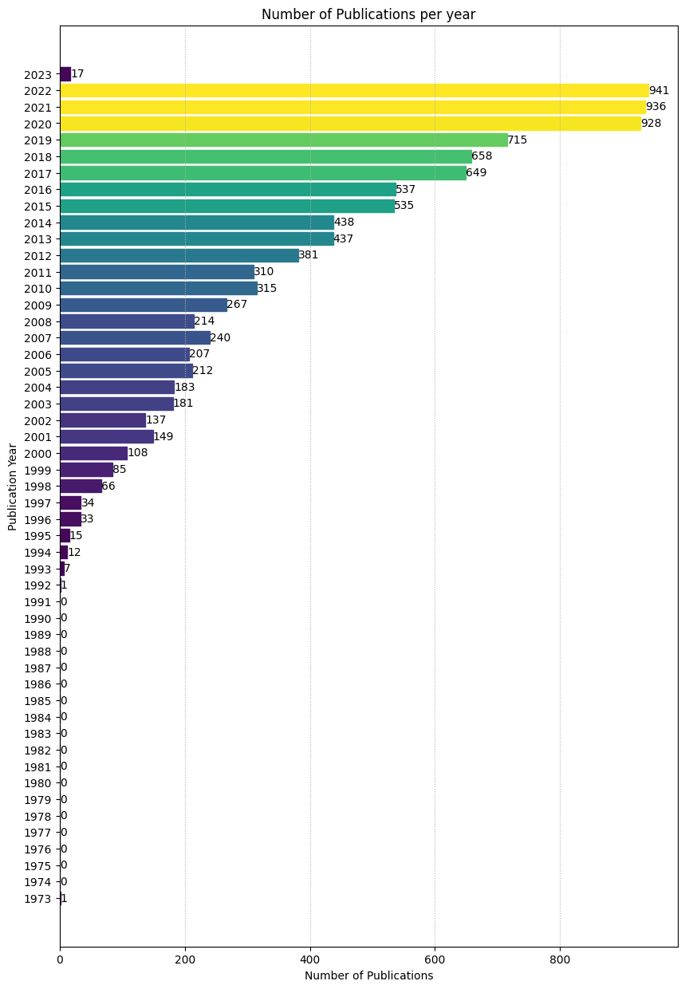
Data Preparation – Insights from Data
We can clearly see from this horizontal bar plot that the number of publications per year has increased through the years.
And there is hardly any publications before 1992.

Slide 23
Modelling
There are 2 types of models that is being used in this project:
Latent Dirichlet Allocation (LDA) Models:
LatentDirichletAllocation from sklearn.decomposition
LdaModel from gensim.models
Named Entity Recognition (NER) Models:
I have used couple of pre-trained models of scispacy library,
there are 3 in this project;
en_ner_bionlp13cg_md and en_ner_bc5cdr_md are biomedical entity recognition models
and at last English language model en_core_web_sm.

Slide 24
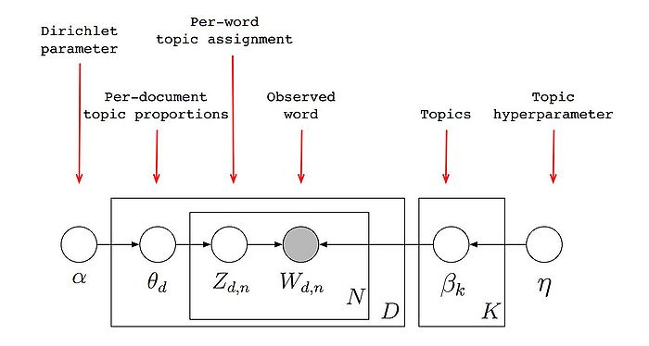
Modelling – LDA Models

Slide 25
Modelling – LDA Models
Finding Optimal Number of Topics
I've used the Gensims’s topic coherence pipeline coherencemodel
to find the optimal number of topics based on the cv metric.
To do this, I've used LdaModel and CoherenceModel from gensim.models.

Slide 26
Modelling – LDA Models
Finding Optimal Number of Topics
LdaModel class in gensim.models library takes many (optional and required) arguments these are used:
First it takes a Bag-of-Words (BoW) representation of corpus. (Document-term matrix.)
Then it takes num_topics, which is number of topics for model to divide.
id2word parameter is used for mapping from word IDs to words. It is used to determine the vocabulary size, as well as for debugging and topic printing.
Last parameter passes determines the number of passes through the corpus during training.

Slide 27
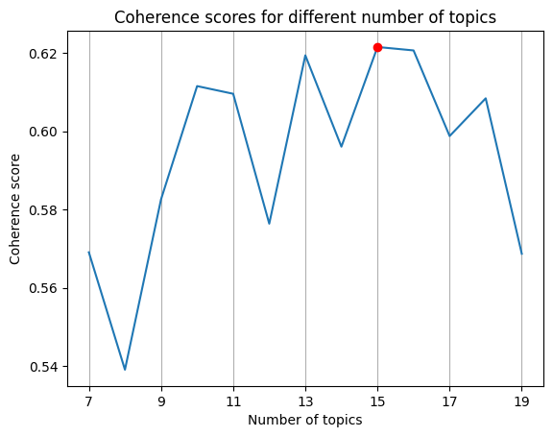
Modelling – LDA Models
Finding Optimal Number of Topics

Slide 28
Modelling – LDA Models
Now that I have found optimal number of topics to be 15
I can create the optimal LDA Models.

Slide 29
Modelling – LDA Models
LatentDirichletAllocation class in sklearn.decomposition library takes many (optional and required) arguments these are used:
It takes n_components, which is basically number of topics.
And random_state attribute that controls the random number generator.
We can then use lda.fit(X) to learn model for the data X with variational Bayes method.
Or we can use lda.transform or lda.fit_transform methods to transform the data.

Slide 30
Modelling – NER Models
For entity relationship models I have used the pre-trained models from scispacy since this library already has NER models for specific entity recognition tasks.
Such as en_ner_bionlp13cg_md and en_ner_bc5cdr_md
and from spacy I used the English language model en_core_web_sm.
(en_core_web_sm model is not about biomedical texts.).

Slide 31
Modelling – NER Models
Example of loading the models from spacy.
import scispacy
import spacy
# Load the en_ner_bionlp13cg_md model
nlp_bionlp13cg = spacy.load("en_ner_bionlp13cg_md")
# Load the en_ner_bc5cdr_md model
nlp_bc5cdr = spacy.load("en_ner_bc5cdr_md")
# Load the English language model
nlp = spacy.load('en_core_web_sm')

Slide 32
Evaluation

Slide 33
Evaluation
Evaluation of LDA Model from sklearn.decomposition
Using the LDA model from sklearn.decomposition I extracted frequencies for each word in the topics.

Slide 34
Evaluation
Evaluation of LDA Model from sklearn.decomposition
Output of the words with top 3 frequencies looks like this:
word = expans, TF(Term Frequency)-IDF value = 217.35958169601946
word = cell, TF(Term Frequency)-IDF value = 304.1889725565113
word = repeat, TF(Term Frequency)-IDF value = 424.1320513990723
NEXT-TOPIC
word = polymorph, TF(Term Frequency)-IDF value = 1152.7826721971762
word = cancer, TF(Term Frequency)-IDF value = 1187.9846553036255
word = risk, TF(Term Frequency)-IDF value = 1311.822002337407
NEXT-TOPIC
word = hepatocellular, TF(Term Frequency)-IDF value = 339.18008173656654
word = as1, TF(Term Frequency)-IDF value = 854.837195245439
word = hcc, TF(Term Frequency)-IDF value = 1541.5365058347973
…

Slide 35
Evaluation
Evaluation of LDA Model from sklearn.decomposition
Using frequencies of words, I've made a word cloud using pytagcloud. This word cloud is for the whole data.

Slide 36
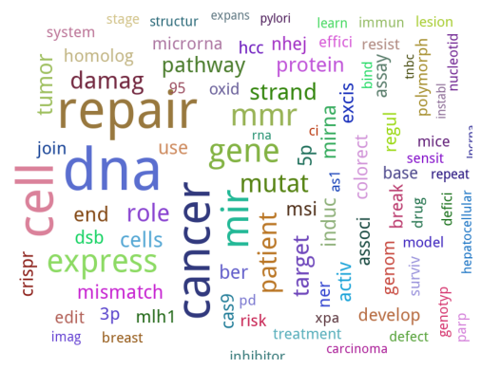
Evaluation
Evaluation of LDA Model from sklearn.decomposition
Using frequencies of words, I've made a word cloud using pytagcloud. This word cloud is for the whole data.

Slide 37
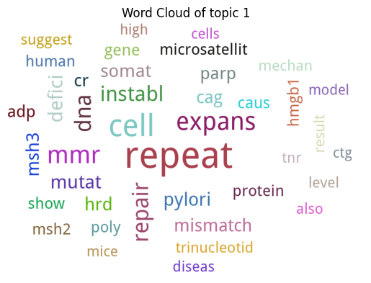
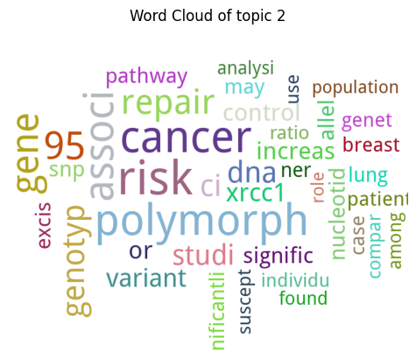
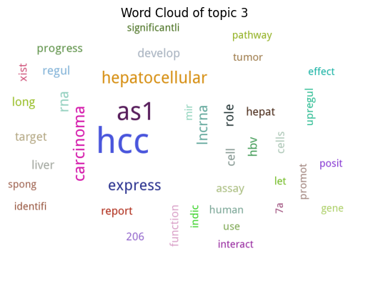
Evaluation
Evaluation of LDA Model from sklearn.decomposition
Here are the word clouds for each of the topics.

Slide 38
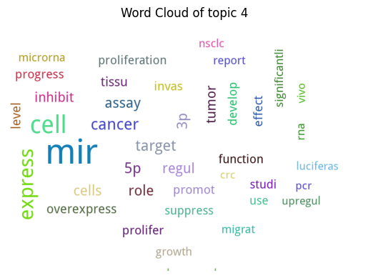
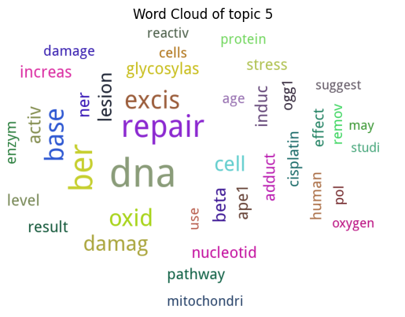
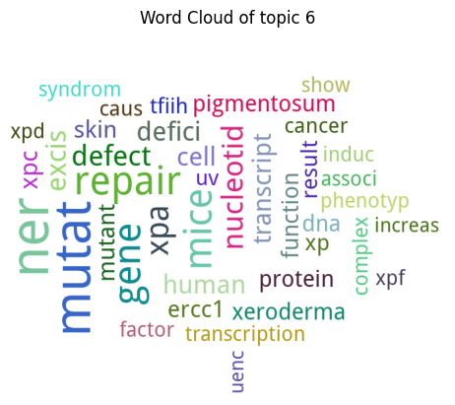
Evaluation
Evaluation of LDA Model from sklearn.decomposition
Here are the word clouds for each of the topics.

Slide 39
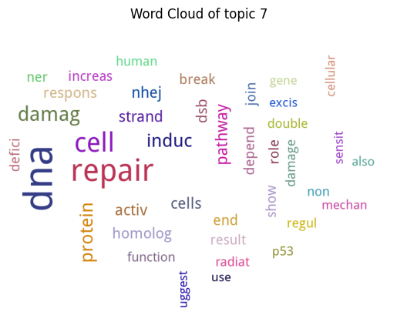
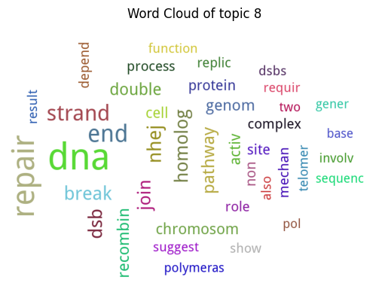
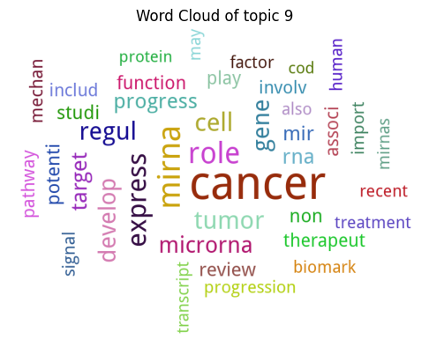
Evaluation
Evaluation of LDA Model from sklearn.decomposition
Here are the word clouds for each of the topics.

Slide 40
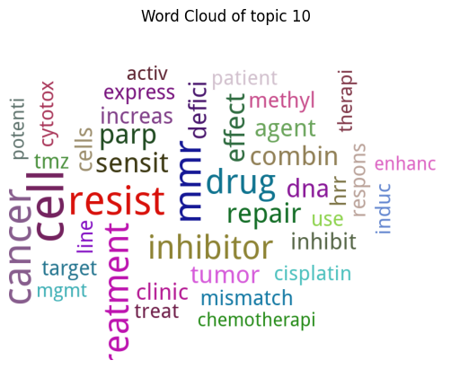
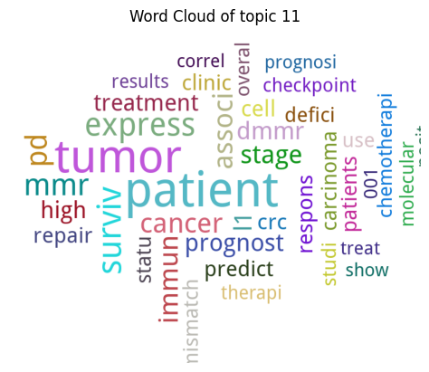
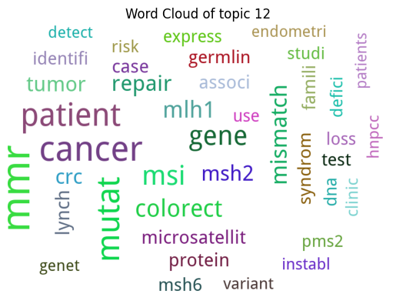
Evaluation
Evaluation of LDA Model from sklearn.decomposition
Here are the word clouds for each of the topics.

Slide 41
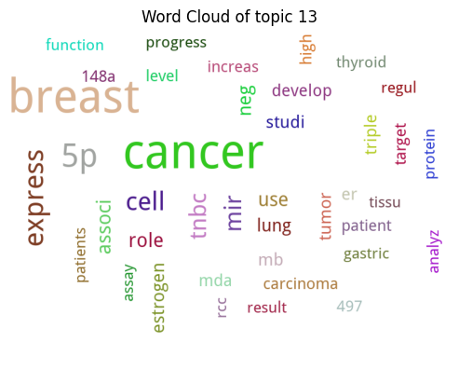
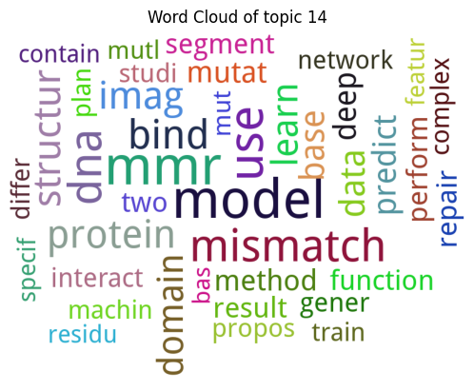
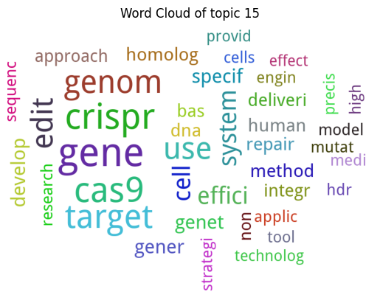
Evaluation
Evaluation of LDA Model from sklearn.decomposition
Here are the word clouds for each of the topics.

Slide 42
Evaluation
Evaluation of LDA Model from sklearn.decomposition
Using the attributes of the LDA model of sklearn.decomposition library, I put the word and their relative weights(frequency) into a dataframe to see the results better. Topic column of the dataframe shows the topics, for each topic to keep it simple I put the words with top 5 frequencies.

Slide 43
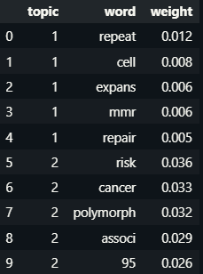
Evaluation
Evaluation of LDA Model from sklearn.decomposition
DataFrame of Word-Weight for each topic
(Only the first 2 topics shown.)

Slide 44
Evaluation
Evaluation of LDA Model from gensim.models
Using LDA model from gensim.models I made topic clusters, that stores the articles based on what is their most dominant topics are.
Based on this I will create trend analysis with articles and topics.
For each article that published after 2000 (Since there aren't many articles before that I discarded the rest), using the topic_clusters list, I've grouped the articles that are similar and published in the same year into count_similar_articles_per_year list and then grouped them just by year to get total count of published articles for each year and stored it in count_total_articles_per_year list.
Using these two lists I found the normalized frequency of publications for each year.

Slide 45
Evaluation
Evaluation of LDA Model from gensim.models
Example of normalized frequency of publications for each year for topic cluster 1.
Topic cluster 1: {'2000': 0.14814814814814814, '2001': 0.1476510067114094, '2002': 0.12408759124087591, '2003': 0.16574585635359115,
'2004': 0.09836065573770492, '2005': 0.17452830188679244,
'2006': 0.15942028985507245, '2007': 0.1625, '2008': 0.1822429906542056,
'2009': 0.13108614232209737, '2010': 0.14285714285714285,
'2011': 0.14516129032258066, '2012': 0.14435695538057744,
'2013': 0.13501144164759726, '2014': 0.1461187214611872,
'2015': 0.15327102803738318, '2016': 0.14338919925512103,
'2017': 0.15408320493066255, '2018': 0.135258358662614,
'2019': 0.16643356643356644, '2020': 0.1540948275862069,
'2021': 0.16666666666666666, '2022': 0.14452709883103082,
'2023': 0.11764705882352941}
…

Slide 46
Evaluation
Evaluation of LDA Model from gensim.models
For trend analysis I used Mann-Kendall test, used original_test function from pymannkendall, which returns:
trend: tells the trend (increasing, decreasing or no trend)
h: True (if trend is present) or False (if the trend is absence)
p: p-value of the significance test, I conducted the tests at a significance level of α = 0.05 thus if p-value is less than 0.05 it is rejected (No trend in the data.).
z: normalized test statistics
Tau: Kendall Tau
s: Mann-Kendal's score
var_s: Variance S
slope: Theil-Sen estimator/slope
intercept: intercept of Kendall-Theil Robust Line, for seasonal test, full period cycle consider as unit time step
Check the official website for more information on the subject:
https://pypi.org/project/pymannkendall/

Slide 47
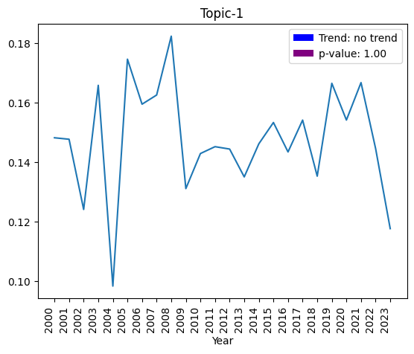
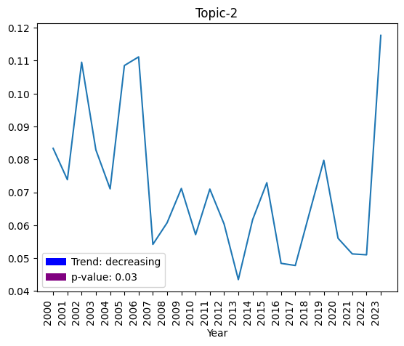
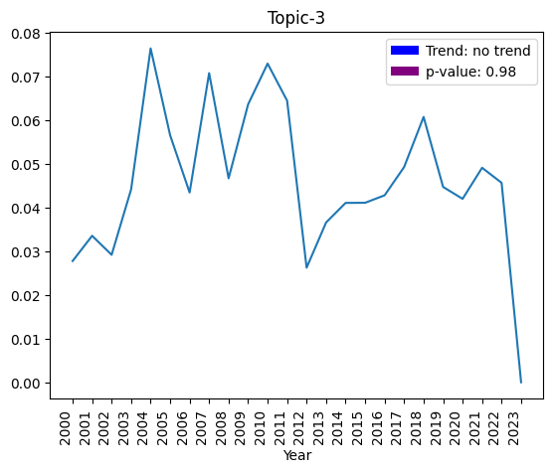
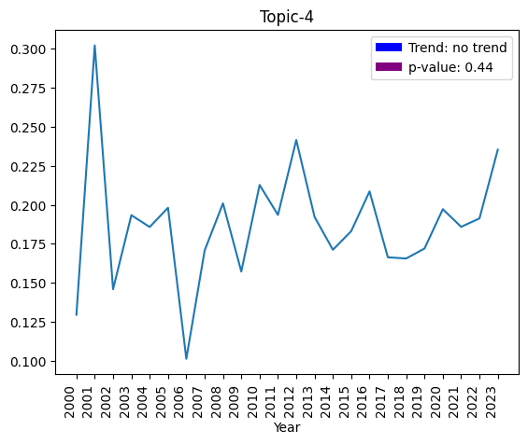
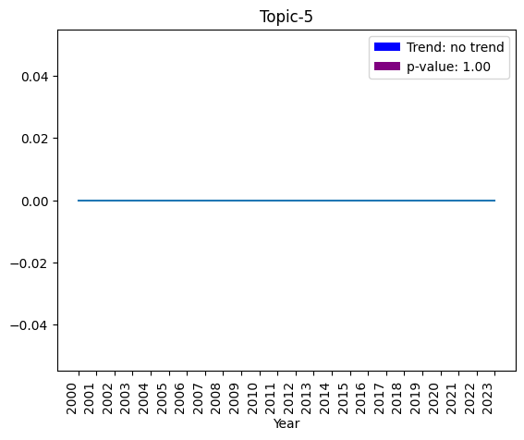
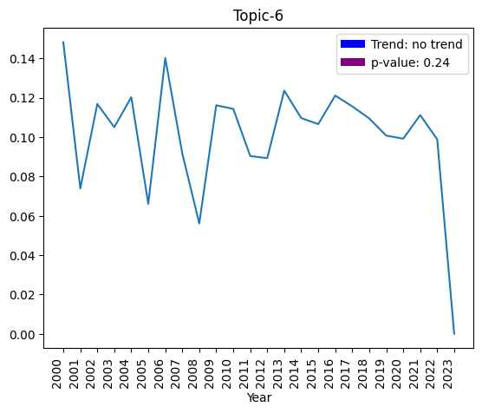

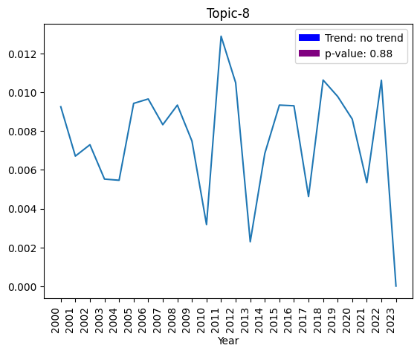
Evaluation
Evaluation of LDA Model from gensim.models
Trend Analysis for each of the topics

Slide 48
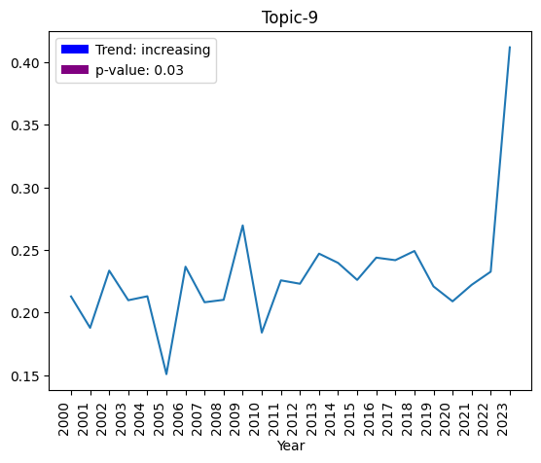
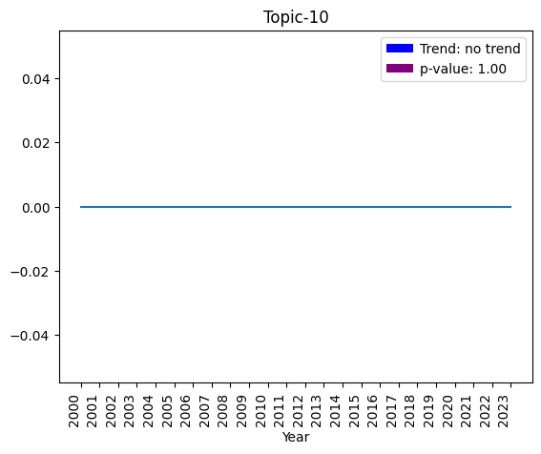
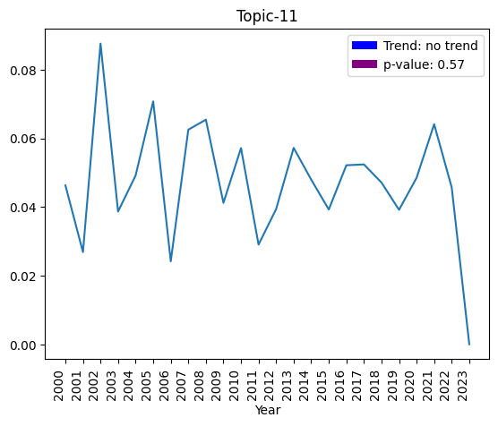
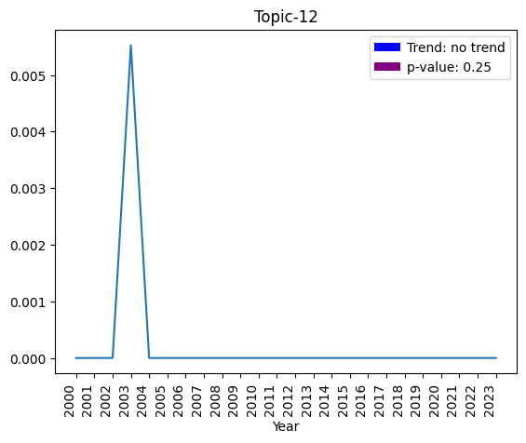


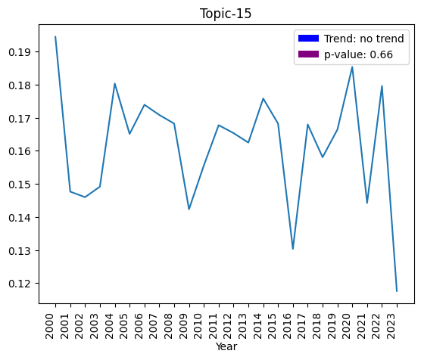
Evaluation
Evaluation of LDA Model from gensim.models
Trend Analysis for each of the topics

Slide 49
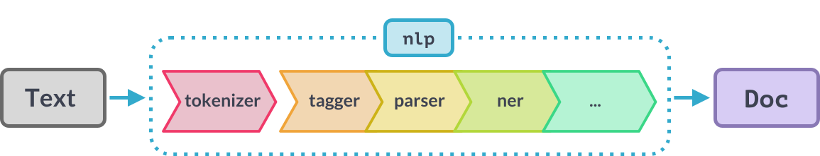
Evaluation
Evaluation of Named Entity Recognition (NER) Models
Language Processing Pipeline

Slide 50
Evaluation
Evaluation of Named Entity Recognition (NER) Models
To get a processed text we need to call NLP(Natural Language Processor) object on a string. It will return a processed document.
doc_bionlp13cg = nlp_bionlp13cg(text)
doc_bc5cdr = nlp_bc5cdr(text)
doc_core = nlp(text)

Slide 51
Evaluation
Evaluation of Named Entity Recognition (NER) Models
Using displacy
Displacy is a visualizer tool that is provided by spacy library.
If the jupyter parameter set to False it will return html file and if it’s True it will display it on jupyter.
With the ability to get the return value as html, we can easily implement it into any website.

Slide 52
Evaluation
Evaluation of Named Entity Recognition (NER) Models
Using displacy
Here I've rendered the docs that I've gathered from NER models to display it.
(Displaying only a small portion of the data.)
from spacy import displacy
displacy.render(doc_bionlp13cg[:100], jupyter=True, style="ent", options=options)
displacy.render(doc_bc5cdr[:100], style="ent", jupyter=True,options=options) displacy.render(doc_core[:100], jupyter=True, style="ent")

Slide 53
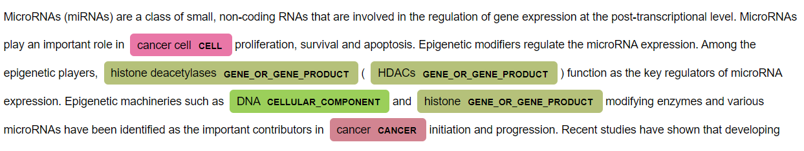
Evaluation
Evaluation of Named Entity Recognition (NER) Models
Using displacy with en_ner_bionlp13cg_md model.
displacy.render(doc_bionlp13cg[:100], jupyter=True, style="ent", options=options)

Slide 54
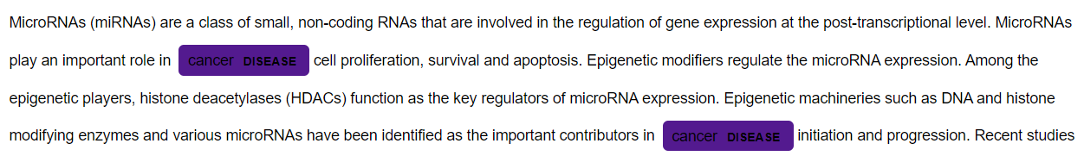
Evaluation
Evaluation of Named Entity Recognition (NER) Models
Using displacy with en_ner_bc5cdr_md model.
displacy.render(doc_bc5cdr[:100], jupyter=True, style="ent", options=options)

Slide 55
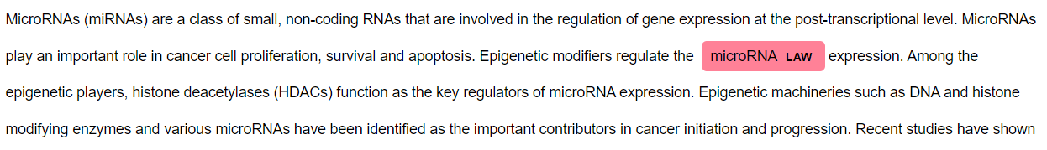
Evaluation
Evaluation of Named Entity Recognition (NER) Models
Using displacy with en_core_web_sm model.
displacy.render(doc_core[:100], jupyter=True, style="ent", options=options)

Slide 56
Evaluation
Evaluation of Named Entity Recognition (NER) Models
displacy.render(doc_core[:100], jupyter=True, style="ent", options=options)
As you can see here, NER models are not always suitable for the job you need, since this model mostly trained on English language and not on scientific subjects it might give unexpected results for a biomedical text.

Slide 57
Evaluation
Evaluation of Named Entity Recognition (NER) Models
Insight to Entities
I've put together most mentioned gene_or_gene_products and diseases into
seperate lists.
Then I will plot these to see frequencies of these.
These will be simple displays, we can do this for any of the entities or
even combine them.

Slide 58
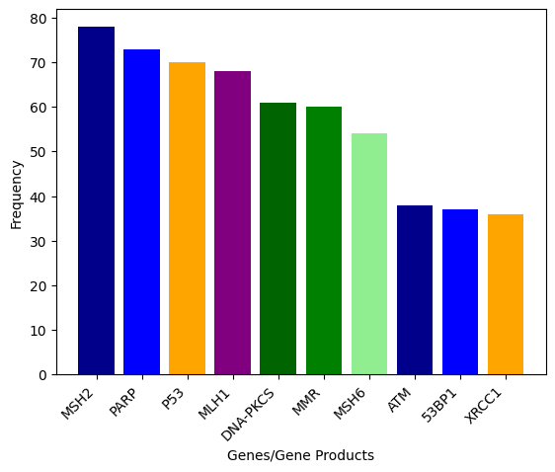
Evaluation
Evaluation of Named Entity Recognition (NER) Models
Insight to Entities

Slide 59
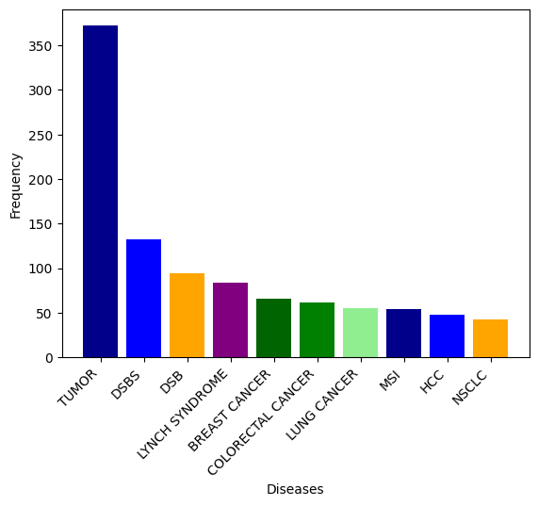
Evaluation
Evaluation of Named Entity Recognition (NER) Models
Insight to Entities

Slide 60
Return Similar Documents

Slide 61
Return Similar Documents
At last, to show functionality of the LDA models, I implemented a search function which takes 4 arguments:
query: Search query, throws an error if it's empty. Results will depend on
the documents.
documents: Documents to search from, provided by implementor, limited to returned articles by Entrez.
lda_model: Expects the LDA model of gensim.models, provided by the implementor, will be used to search similarities.
dictionary: Expects the Dictionary class of gensim.corpora, also will be used to search for similarities.
Note:
Since we are limited to gathered articles from PubMed, and the articles are in the field of biomedical science search queries that are not specific to those fields, would return unsatisfying documents.

Slide 62
Return Similar Documents
Using the yield properties, we can get only 1 article each time we call next.
If there is no more to yield, I will just display "No more articles!".
Since similarities will drop each time, user will get less relevant article for each next.
Search function returns a string that consists of 3 things:
Title of the article
Similarity between the search query (%)
And the link to the original article

Slide 63
Return Similar Documents
First preproccess the search query, then call the search function
# Used for preproccessing the given search query
def preprocess(review):
review = review.lower()
review = review.split()
#gets the root of the word -----> likely >> like
ps = PorterStemmer()
review = [ps.stem(word) for word in review if not word in set(stopwords.words('english'))]
review = [word for word in review if len(word) > 2]
review = ' '.join(review)
return review

Slide 64
Return Similar Documents
Example function call
search_results = search("Properties of DNA", documents, lda_model, dictionary)
print(next(search_results))
Output ->
Title: In vitro repair of complex unligatable oxidatively induced DNA double-strand breaks by human cell extracts
Similarity = 99.0
Link of the article: https://pubmed.ncbi.nlm.nih.gov/40364553/

Slide 65
Save the Models

Slide 66
Save the Models
# Save the model and dictionary to files
lda_model.save("lda_model.model")
dictionary.save_as_text("dictionary.txt")
import pickle
# Save the models to a file
with open("models.pkl", "wb") as f:
pickle.dump((nlp_bionlp13cg, nlp_bc5cdr, nlp), f)

Slide 67
Load the Models

Slide 68
Load the Models
# Load the model and dictionary from files
lda_model = LdaModel.load("lda_model.model")
dictionary = Dictionary.load_from_text("dictionary.txt")
import pickle
# Load the models from a file
with open("models.pkl", "rb") as f:
nlp_bionlp13cg, nlp_bc5cdr, nlp = pickle.load(f)

Slide 69
References

Slide 70
References
https://pubmed.ncbi.nlm.nih.gov/
https://www.kaggle.com/code/binitagiri/extract-data-from-pubmed-using-python
https://www.ncbi.nlm.nih.gov/
https://www.nlm.nih.gov/
https://github.com/biopython/biopython/issues/1867
https://biopythontutorial.readthedocs.io/en/latest/notebooks/09%20%20Accessing%20NCBIs%20Entrez%20databases.html#EFetch:-Downloading-full-records-from-Entrez
https://pandas.pydata.org/docs/reference/api/pandas.DataFrame.plot.html
https://matplotlib.org/stable/api/cm_api.html
https://matplotlib.org/3.1.1/api/_as_gen/matplotlib.pyplot.barh.html
https://towardsdatascience.com/end-to-end-topic-modeling-in-python-latent-dirichlet-allocation-lda-35ce4ed6b3e0
https://www.reddit.com/r/ProgrammerHumor/comments/dbdflz/funny_data_science_motto/

Slide 71
References
https://scikit-learn.org/stable/modules/generated/sklearn.decomposition.LatentDirichletAllocation.html
https://youtu.be/TKjjlp5_r7o
https://radimrehurek.com/gensim/models/coherencemodel.html
https://allenai.github.io/scispacy/
https://spacy.io/usage/visualizers
https://stackoverflow.com/questions/18974437/how-to-build-a-clean-word-cloud-using-pytagcloud-without-a-crowded-image-pytho
https://pypi.org/project/pymannkendall/
https://github.com/allenai/scispacy/issues/141
https://leonlok.co.uk/blog/finding-similar-names-using-cosine-similarity/
https://www.dataquest.io/blog/r-api-tutorial/
https://devopedia.org/latent-dirichlet-allocation
https://spacy.io/usage/processing-pipelines

Slide 72
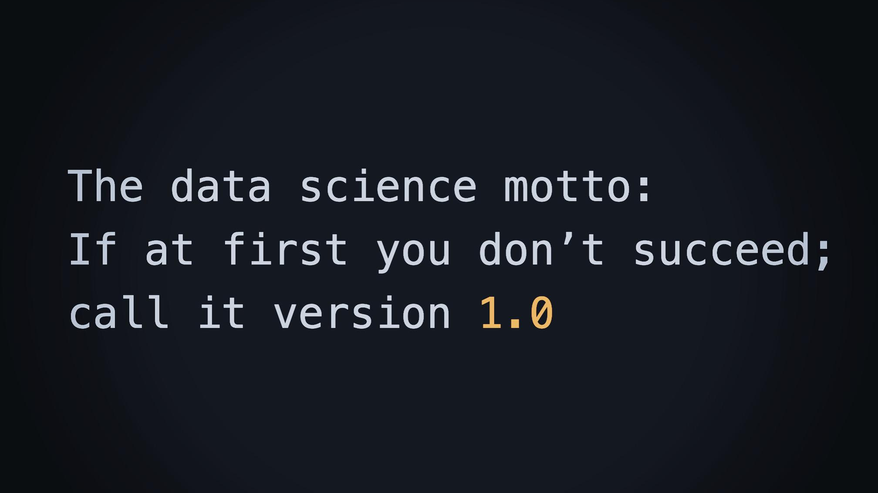
Thanks for listening through the version 1.0

